Slide 1
21CS703
DATA ANALYTICS (Lab Integrated)
Prepare by
Dr. A. GNANASEKAR
Associate Professor
Department of Computer Science & Engineering
R.M.D. Engineering College

Slide 2
UNIT 4 –Mining data streams
Data stream model
Stream queries
Sampling data in a stream
General streaming problem filtering streams
Dealing with infinite streams
  Counting Distance Elements in a Stream
  Estimating Moments
  Counting Ones in Window
  Decaying Windows.

Slide 3
UNIT 4 –Data stream
Data stream refers to the continuous flow of data generated by various sources in real-time.

Slide 4
UNIT 4 –Data stream Model
The data stream model is designed to handle large, continuous, and rapidly arriving data, focusing on real-time, memory-efficient, and approximate computation.

Slide 5
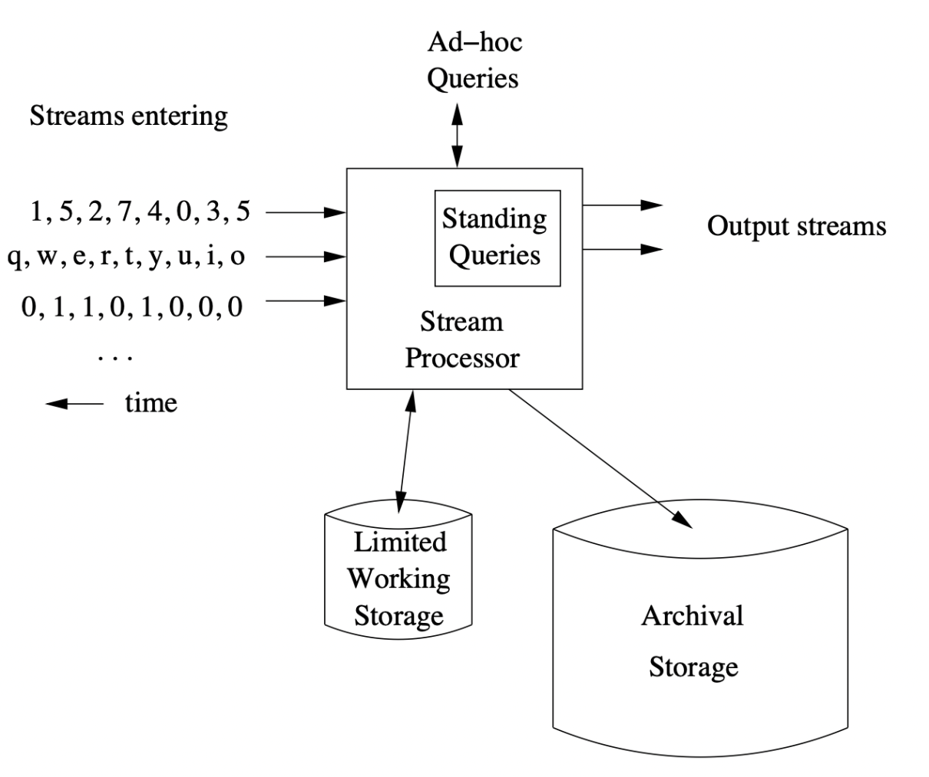
UNIT 4 - Data stream Model

Slide 6
UNIT 4 –Data stream Model
Multiple input streams arrive continuously (numbers, text, bits).
Each incoming event is accepted by the Stream Processor as soon as it arrives. The processor reads the event metadata.
The processor determines the time model it will use: processing-time (when it was seen) or event-time (the event’s own timestamp).
  A Stream Processor handles them in real time using:
  Limited Working Storage → small in-memory state (windows, counters, sketches).
  Standing Queries → continuous queries running all the time.
  Ad-hoc Queries → one-time user queries.
  Archival Storage → long-term data history for batch/offline analysis.
  Processor updates state, applies queries, and produces output streams.

Slide 7
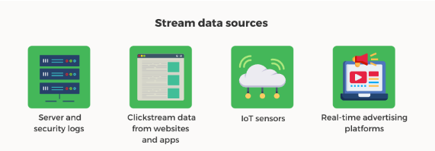
Stream Sources
Sensor data used in navigation systems.
Image data sent down from satellites.
Internet and web traffic received by a bobbing node in the center of the internet.
Server Logs

Slide 8
What are the tools for data streaming?
Key tools for data streaming include:
Message Brokers: Apache Kafka, Amazon Kinesis.
ETL Tools: Apache Flink, Apache Storm, Spark Streaming.
Data Storage: Amazon S3, Google BigQuery, Apache Hadoop.
Analytics Engines: Elasticsearch, Apache Druid.

Slide 9
Stream queries
Stream queries are queries that run on continuously over a data stream, producing instant results, instead of waiting for all data to be stored first.

Slide 10
Stream queries
Types of Stream Queries:
Standing (Continuous) Queries
  Registered once and run all the time, updating results as new data arrives.
  (e.g., average temperature in the last 10 minutes)
2. Ad-hoc Queries
  Run on demand, usually over archived or snapshot data.
  (e.g., max temperature recorded yesterday)
👉 In short:
Standing queries = continuous & live
Ad-hoc queries = one-time & on-demand.

Slide 11
Stream queries
Common Operations in Stream Queries:
Filtering
    select specific events
Aggregation
    count, sum, average over sliding windows.
Join
    combine multiple streams (e.g., sensor + user log).
Pattern Detection
    find trends or anomalies in the stream.

Slide 12
Sampling in data streams
Sampling in data streams is the process of selecting a small representative subset of elements from a continuous stream, since storing all data is impossible.
Why Sampling is Needed
Streams are infinite / high-speed, so full storage is not feasible.
Sampling reduces memory, computation, and storage needs.
Helps in building approximate models or quick summaries.

Slide 13
Sampling in data streams
Sampling in data streams is the process of selecting a small representative subset of elements from a continuous stream, since storing all data is impossible.
Common Sampling Techniques:
  Reservoir Sampling
  Systematic Sampling
  Random Sampling with Probability
  Sliding Window

Slide 14
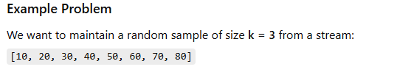
Sampling in data streams
  Reservoir Sampling:
  Reservoir Sampling is a randomized algorithm used to select a sample of k items from a stream (or list) of unknown or very large size N,

Slide 15
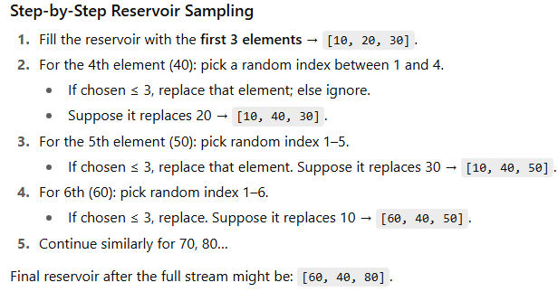
Sampling in data streams

Slide 16
Sampling in data streams
  Reservoir Sampling:
  The purpose of Reservoir Sampling is to enable fair random sampling from very large or unknown-sized datasets/streams without needing to store the entire dataset in memory.

Slide 17
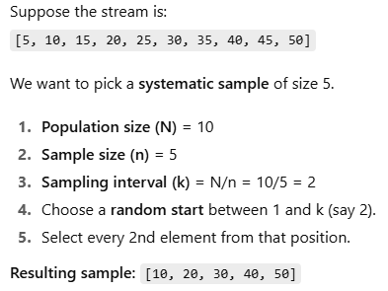
Sampling in data streams
  Systematic Sampling:
  Selects every n-th element from the stream.

Slide 18
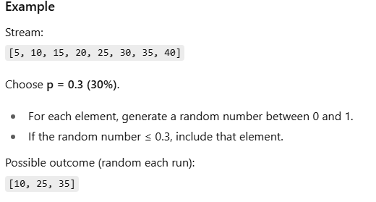
Sampling in data streams
  Random Sampling with Probability:
  Each element is included with probability p.

Slide 19
Sliding Windows
  Example: Maximum Sum Subarray of Size K
  Consider an array arr = {16, 12, 9, 19, 11, 8 } and a window size K = 3.
  The goal is to find the maximum sum of any contiguous subarray of size K
  Algorithm:
  Select first window /sub array from index i to k-1 and find Maximum_sum.
  Slide window by 1
  Find current_sum = previous_sum + added Element – Removed element
  Then check
      if Current_sum>Maximum_sum
      Maximum_sum=Current_sum
  Then continue sliding up to final window.

Slide 20


Sliding Windows
  Sliding Windows (Maximum Sum):

Slide 21


Sliding Windows
Finally Maxmium_sum = 40

Slide 22
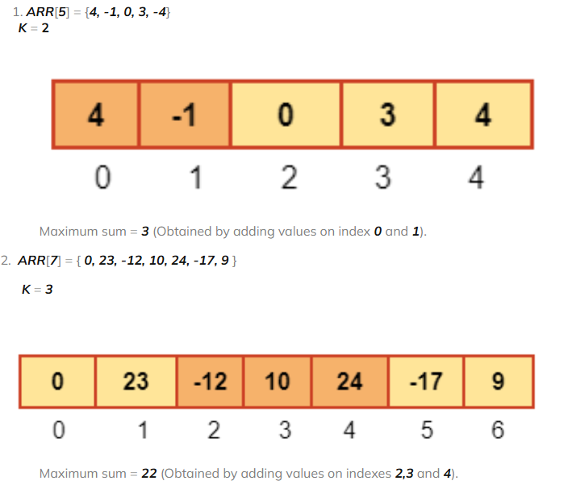
Sliding Windows

Slide 23
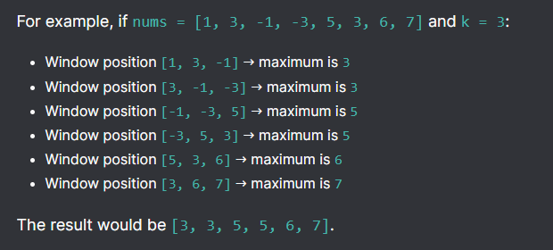
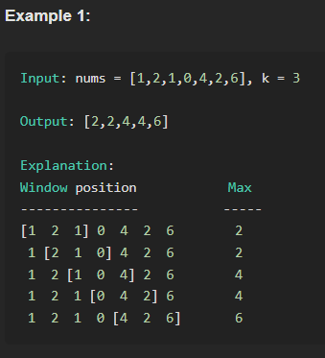
Sliding Windows
  Sliding Windows Maximum:

Slide 24
General streaming problem filtering streams
  Filtering in data streams means selecting only those elements from a continuous stream that satisfy a given condition (predicate), while ignoring the rest.
How It Works:
Input stream → apply filter condition → output stream (only matching items).
Since data arrives continuously, the filter is applied in real time without storing the full stream.

Slide 25
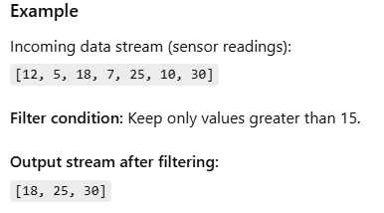
General streaming problem filtering streams

Slide 26
General streaming problem filtering streams
Applications:
Fraud detection → filter transactions above a threshold.
IoT monitoring → filter sensor values outside safe range.
Network security → filter suspicious packets.
Social media analytics → filter posts with certain keywords.

Slide 27


